Slide 1
Galaxy HR Employee Attrition Report
By : Akande S. Damilola
^{20th} September 2024

Slide 2
d
Outlines
Problem Statement
Project Objectives
Recommendations
Insights
Visualizations
Conclusions
Q/A

Slide 3

Problem Statement
The company is experiencing high employee turnover, and there is a need to understand the underlying causes and factors contributing to this issue. The analysis investigates patterns and trends in employee attrition, focusing on demographic characteristics, job roles, and departmental. By uncovering these insights, the goal is to identify key drivers of turnover and provide recommendations to enhance employee retention and reduce overall attrition rates.

Slide 4
Project Objectives
Identify the Reasons for Employee Attrition
Analyze Turnover by Race and Gender
Track Turnover Trends Over Time
Turnover by Department and Location
Monitor the overall number of employees

Slide 5
Recommendations
Targeted Retention Strategies: Develop tailored retention strategies for departments and employee groups with high turnover rates.
Diversity and Inclusion Initiatives: Enhance diversity and inclusion efforts to create a more inclusive work environment for all employees.
Career Development Opportunities: Invest in employee development and provide clear career paths to retain top talent.
Exit Interviews: Conduct thorough exit interviews to gather feedback from departing employees and identify areas for improvement.
Remote Work Policies: Evaluate the effectiveness of remote work policies in these regions and explore potential adjustments.
Flexible Work Arrangements: Consider providing more flexible work arrangements, such as remote work or flexible hours, to accommodate the needs of younger employees.
Mentorship Programs: Establish mentorship programs that pair employees from different backgrounds.

Slide 6
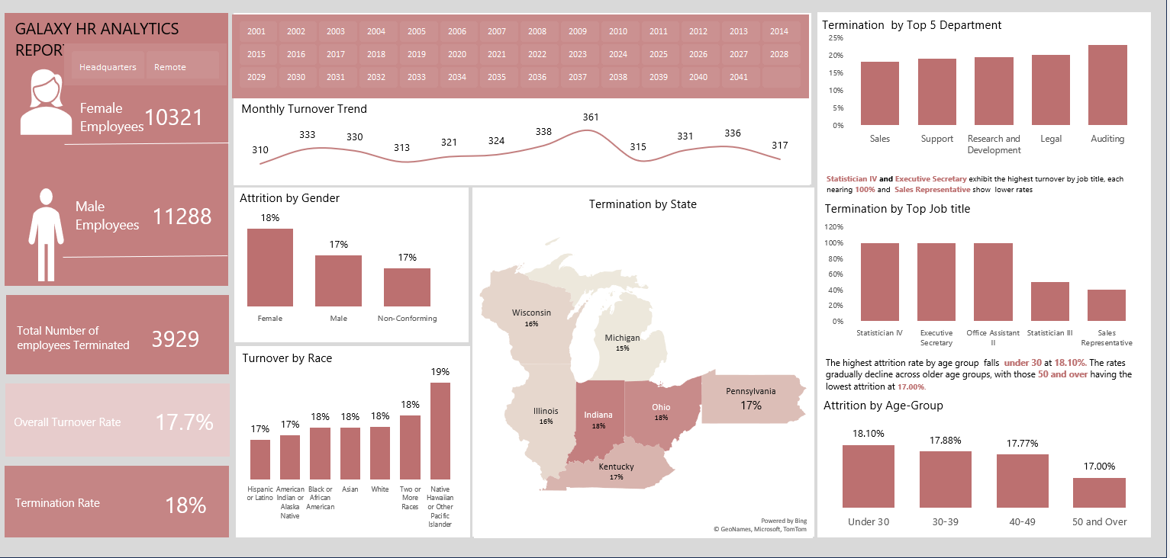
Dashboard Overview

Slide 7

Insights :KPIs
3,929
Total Number of Employees Terminated
17.7%
Overall Turnover Rate
18%
Termination Rate
F
From the data , it was discovered that the total number of Employees Terminated is 3,929 ,while the Overall Turnover Rate is 17.7%.

Slide 8
Insights and Visualizations
Key findings
•Auditing departments are showing higher turnover rates, while sales departments have lower rates.

Slide 9
Insights and Visualization
Key findings
•The highest attrition rate by age group falls under 30 at 18.10%. The rates gradually decline across older age groups, with those 50 and over having the lowest attrition at 17.00%.

Slide 10
Insights and Visualization
Key findings
•Some racial groups like Native Hawaiian are more likely to leave the company than others

Slide 11
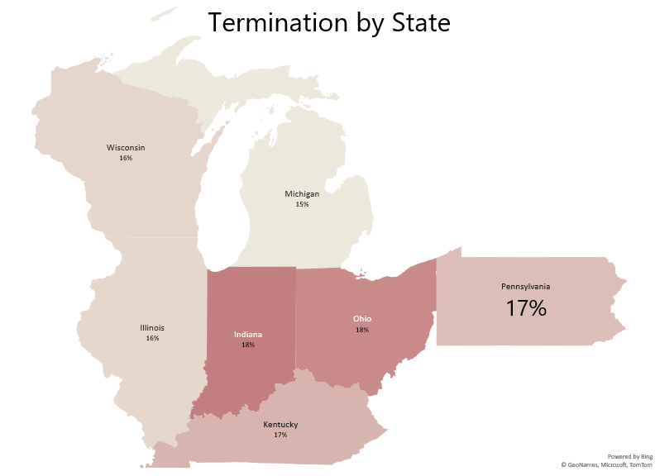
Insights and Visualization
Key findings
• Pennsylvania regions has higher turnover rates at 17%

Slide 12
Insights and Visualization
Key findings
•Statistician IV and Executive Secretary exhibit the highest turnover by job title, each nearing 100% and Sales Representative show lower rates

Slide 13
Insights and Key Findings
The company is experiencing an overall turnover rate of 17.7%.
Female employees have a slightly higher attrition rate than male employees.
Statistician IV and Executive Secretary exhibit the highest turnover by job title, each nearing 100% and Sales Representative show lower rates
The highest attrition rate by age group falls under 30 at 18.10%. The rates gradually decline across older age groups, with those 50 and over having the lowest attrition at 17.00%.
Some racial groups are more likely to leave the company than others.

Slide 14
Conclusions
The Galaxy HR Analytics Dashboard provides a comprehensive overview of employee turnover within the organization. The analysis reveals that turnover is influenced by a complex interplay of factors, including gender, department, geography, age, and race.
By implementing targeted retention strategies, promoting diversity and inclusion, and investing in employee development.

Slide 15
THANK YOU!
Do you have any questions?

